Slide 1

High Availability Options for Azure SQL
Emily Lisa – PM Azure Data – emlisa@microsoft.com
Notes:
Talking to you right now in my living room that my roommates graciously let me use for this presentation. As I’m sure is a similar experience for many of you, after the pandemic hit many things suddenly and unexpectedly shut down and in response we all had to find new ways and places to adapt for our daily jobs, conferences, vacations, really all aspects of our lives. Through this experience I've realized how important it is to recognize that nothing is perfect, unexpected things happen and that is crucial to be ready to adapt to unexpected changes in order to stay “available”. Like how unexpected things have happened recently in our lives, databases are also not immune to abrupt changes. At any moment a natural disaster can take out an entire datacenter, a network failure can impact the functionality of a few servers, and many other unexpected events can occur potentially jeopardizing the availability of your database. We embrace this reality by actively working to minimize the effects of a single failing component with as little downtime as possible. Today I’ll be talking about how we can embrace how unpredictable our world is by using systems that actively account for mistakes to be made and for things to break.
Photo source: https://www.signalconnect.com/blog/3-rv-road-trip-tips/

Slide 2
Agenda
HA concepts
History of HA through SQL Server
Azure SQL High Availability
Zone Redundancy
Summary

Slide 3

HA Concepts
getting on the same page
Notes:
Photo source: https://unsplash.com/photos/wC69cxOE7Us

Slide 4


HA vs. DR
High Availability
Disaster Recovery
Quick recovery to provide business continuity
Continuous availability with reliance to failures
In-region millisecond or sub-millisecond failovers
Failover across regions during large-scale disruptions
Synchronous replication
Asynchronous replication
Uptime Percentage
RPO and RTO
Notes:
While high availability and disaster recovery are similar concepts, they actually target different scenarios.
The goal of high availability is to have continuous availability of the database with resilience to local failures. This covers recovery from local hardware and software failures in an automated way that is transparent to the applications that use the database. On the other hand the goal of disaster recovery is to quickly recover the database from a failure to provide business continuity and protect the business by minimizing any data loss.
The failovers have no disruption to the users and occur in millisecond or sub-millisecond time. The scope for high availability is hardware and software failures within a region. On the other hand disaster recover has longer time to failover since the scope is across regions for larger scale disruptions.
Synchronous replication – primary waits on making more changes until a majority of the secondaries respond. Helps prevent data loss since there is no lag between when the transaction commits and when it is replicated and thus primaries and secondaries are synchronized.
. Async primary keeps making changes without confirmation from secondaries. Work well for long distance synchronization.
HA is typically measured in percent of uptime for the service whereas Disastery recovery is measured by RPO and RTO. RPO is Recovery Point Objective which is essentially the amount of data loss from an outage. RTO Recovery Time objective amount of time to restart after an outage.

Slide 5
Demystifying the 9’s
SLA = Service Level Agreement aka “money back if we don’t meet it”.
Availability = ​% uptime. Defined per company
Availability % | Downtime (min/month)
90% | 4,380
99% | 438
99.9% | 43.8
99.95% | 21.9
99.99% | 4.38
99.995% | 2.19
“One Nine”
“Two Nines”
“Three Nines”
“Four Nines”
Notes:
Microsoft and AWS:
Downtime = all continuous attempts by Customer to establish a connection to the Database within the minute fail
Google:
2nd gen: all connection requests to multi zone fail
1st gen: more than 20% server side error rate
Oracle:
In state of “Region Unavailable”
API Error Rate
Dedicated Circuit is “Unavailable”

Slide 6

History of HA Through SQL Server
a walk through time
Notes:
Photo source: http://neat-stuff-blog.blogspot.com/2010/12/vintage-street-views.html

Slide 7
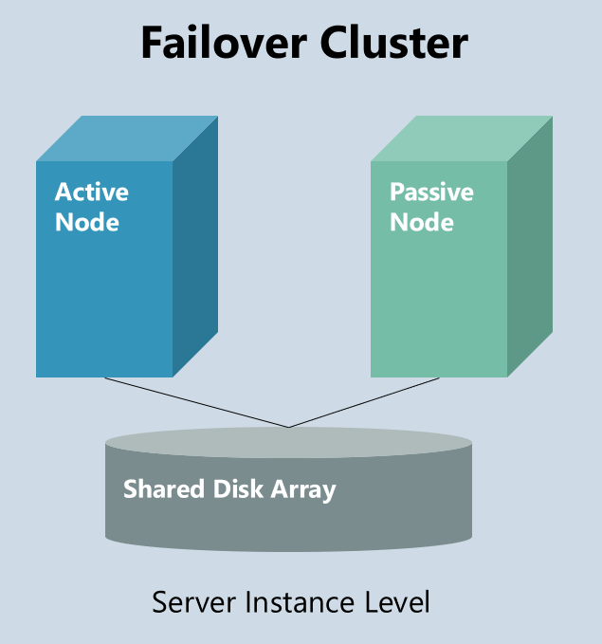
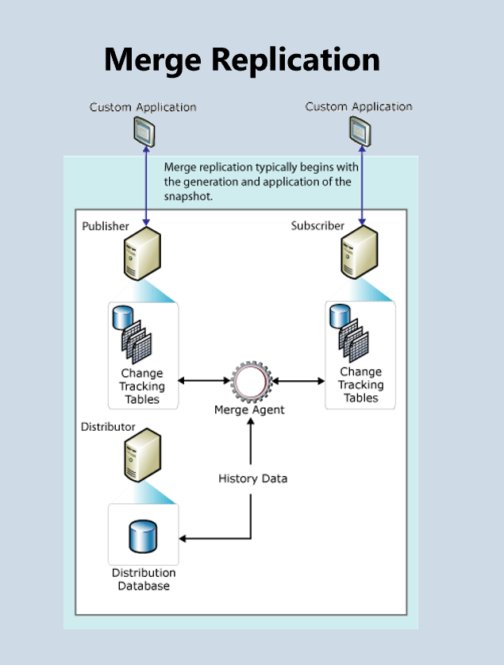
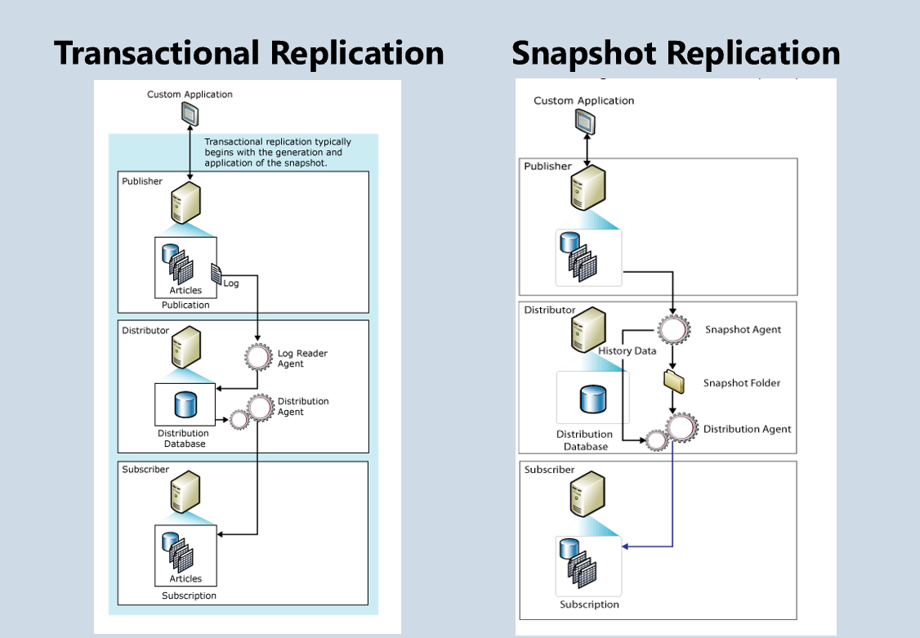
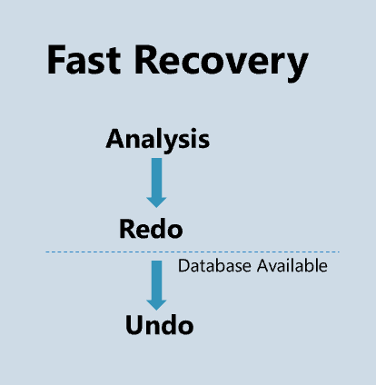
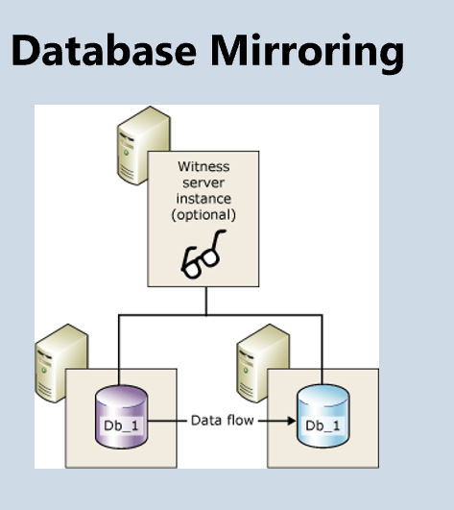
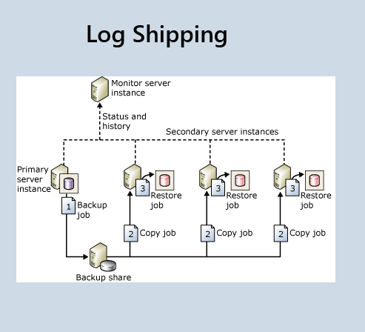
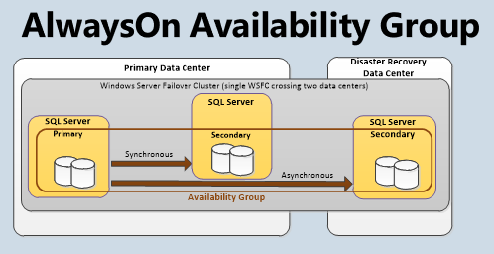
History of HA for SQL Server
Transactional Replication
Snapshot Replication
Merge Replication
Accelerated Database Recovery
Always on Availability Groups
1989
SQL Server 1.0
1998
SQL Server 7.0
2005
SQL Server 2005
2016
SQL Server 2016
1995
SQL Server 6.0
2000
SQL Server 2000
2012
SQL Server 2012
2019
SQL Server 2019
Local db and tlog backups
Failover Cluster
Log Shipping
Database Mirroring
Fast Recovery
Enhanced Always on Availability Groups
Notes:
1989
First edition of SQL server released!
While SQL server has always had ACID properties for recovery the initial storage and compute resiliency was minimal.
All of the "HA" that existing in initial editions was based around local database and transaction log backups that were applied on the same server.
Backups were often not very frequent with logs typically being backed up about once a day
Hard drives went out a lot back in the day, less sophisticated hardware than today
In order to account for this some customers would build there own replication solutions by standing up another server and continuously restoring backups on it.
Any automation for a solution like this was very complex to implement and involved a lot of manual work to figure out how best to monitor health and how to adjust when hardware fails.
Most customers just depended on local backups as full HA solution
1995
Replication introduced!
We provide ability to set up another server and send data from primary server to it.
Often used to have some read workloads offloaded to another server
Could also be used as a starting point for HA but this required manual failover and also required reconfiguring app and client configuration to connect to this over server instead which was complicated and time consuming. Often people continued to simply restore on the same server.
Transactional replication - . Good for high volume of insert, update, and delete activity and when need speedy updates keep track of incremental changes rather than net change
Snapshot replication - Good for infrequent data changes, acceptable to have out of date copies, replicate small volume data. Distribute data exactly how it appears at a given moment.
1998
Failover cluster
Leveraged Windows Failover Clustering technology to provide local HA at the server instance level through failover from one node to another if the current node becomes unavailable.
Game changer for 2 reasons:
Provided an automated way to detect a failover problem
Solved the issue of having to reconfigure app and client connections to a replica. Failover clusters provided a virtualization of node connections with virtual network names which allowed for simple redirection to another node without manually reconfiguring the app and client connection information.
Main drawback: shared storage between nodes so storage was a single point of failure
Log Shipping
Not discuss too much since more of a disaster recovery solution than HA
Allows you to automatically send transaction log backups from primary to secondary on separate secondary servers
Automates process of customers standing up a server and continuously restoring backups that customers did in 1989
2000
Merge replication introduced
Not get to much into details of how this works but important to note that a third type of replication was introduced
Allows various sites to work and make changes autonomously and later merge updates into a single, uniform result using the merge agent
2005
Mirroring
As transactions written to principal database they are sent to a mirrored database as well with a witness acting as an intermediary to determine when to failover.
Automated failover solution like a failover cluster but with no shared storage. No longer have storage as single point of failure
Only have 1 replica to mirror to.
Based on server health not health of database. Database can have issues but if server detected as healthy the database would not failover.
Fast Recovery:
Whenever database recovery happens goes through 3 phase process
Analysis
Analyze the state of each transaction that occurred since the last successful checkpoint
Redo
Bring database to the state it was at before crash be redoing all committed operations
Undo
Roll back and undo operations that were performed by transactions that were active during time of crash
Undo was the step that took the longest time to complete. Until 2005 couldn't access database until undo was finished, fast recovery allowed database to be accessible after redo phase by maintaining locks during undo phase to avoid any inconsistency issues. Now database become available again much sooner
2012
Always on Availability Groups
Mirroring introduced in 2005 was the predecessor to Always on AG which is the availability solution for sql server used today which leverages Windows Failover Clustering technology .
Rather than the 1 replica offered by mirroring now have multiple replicas and support for both synchronous and asynchronous replication
Provided a was to group together multiple databases into a single unit of failover. Expand virtualization piece with AlwaysOn listener that accepts centralized requests to these HA groups with a unique IP and virtual network name.
Secondary's could also be configured to handle read only work loads. Allowing replicas to be used for offloading these read workloads and HA solution.
2016
Enhanced AGs
Failover now based on health of database rather than health of server. Unhealthy databases will failover
Turbo charges availability groups to be much faster.
Distributed availability groups allowed Availability groups to be chained together regardless of if they were in same Windows Server Failover Clustering
5 -> 8 replicas supported
2019
Accelerated database recovery
Fast recovery from 2005 got even faster.
Redesigned the engine recovery process so that recovery time is not impacted by long running transactions. Optimizations made recovery time is now constant time rather than dependent on the number and size of active transactions in the system.
Further enhancements to AGS
Such as 5 synchronous replicas and 9 total replicas

Slide 8

Azure SQL High Availability
have your data in the clouds
Notes:
Photo source: https://www.deviantart.com/shera00/art/Vintage-sky-200358808

Slide 9



Azure SQL
A unified SQL portfolio built on the industry-leading SQL Server engine
SQL Server on Azure Virtual Machines
Azure SQL Managed Instance
Azure SQL Database
Best for re-hosting and apps requiring OS-level access and control
Automated manageability features and OS-level access
Best for modernizing existing apps
Offers high compatibility with SQL Server and native VNET support
Best for building new apps in the cloud
Pre-provisioned or serverless compute and Hyperscale storage to meet demanding workload requirements
Infrastructure as a Service
Platform as a Service
Notes:
Multiple offerings fall under the Azure SQL umbrella, all of which are built on the SQL Server engine
VM - IaaS you manage stack up to and included O/S, we manage the rest.
Best for customers who require ultimate control over SQL and operating system who use features like Polybase, Filestream, and want 3rd party software installed side by side. Has 100% code compatibility with SQL Server and gives access to latest SQL Server updates and releases
PaaS you manage stack up to O/S, we manage rest of stack starting at O/S.
MI – nearly 100% compat with on prem or increased control network traffic between app and data tier with native VNET support.
DB – best for customers who are building new apps in the cloud who want fast provisioning and scalability. Have options for both serverless and provisioned compute. Also has different performance tiers for targeted for different kinds of applications including hyperscale which allows for highly scalable storage and compute. Today’s presentation focus on non-hyperscale tiers in order to scope down the session for this hour, however Hyperscale is also a highly available solution with built in replication across all of it’s layers. You can learn more about the details of the highly available hyperscale architecture in the high availability public documentation for azure sql.

Slide 10
HA overview
Remove virtually all infrastructure maintenance with Azure SQL Database, which provides automatic software patching as part of the service.
Built-in maintenance
Built-in system replicas help deliver inherent data protection and database uptime. System replicas are automatically moved to new machines as old machines fail.
Fault tolerance
Notes:
Hands free experience.
Built-in maintenance - Virtually all infrastructure maintenance with SQL Database is automatically handled as part of the service such as patching, backups, Windows and SQL upgrades, as well as unplanned events such as underlying hardware, software, or network failures. This allows customers get the full benefit of replicated databases without having to configure or maintain complicated hardware, software, OS or virtualization environments.
Fault tolerance -
Fault tolerance is built in to each Azure SQL database with replicas using the quorum writes technique to automatically deliver inherent data protection, database uptime, and system stability. These system replicas are also automatically moved to new machines, which are provisioned anytime, anywhere as old machines fail. The Service Fabric failover system is used for failovers which are fully automated without loss of any committed data. The routing of connections to the primary replica is dynamically managed by the service with no application logic required.

Slide 11
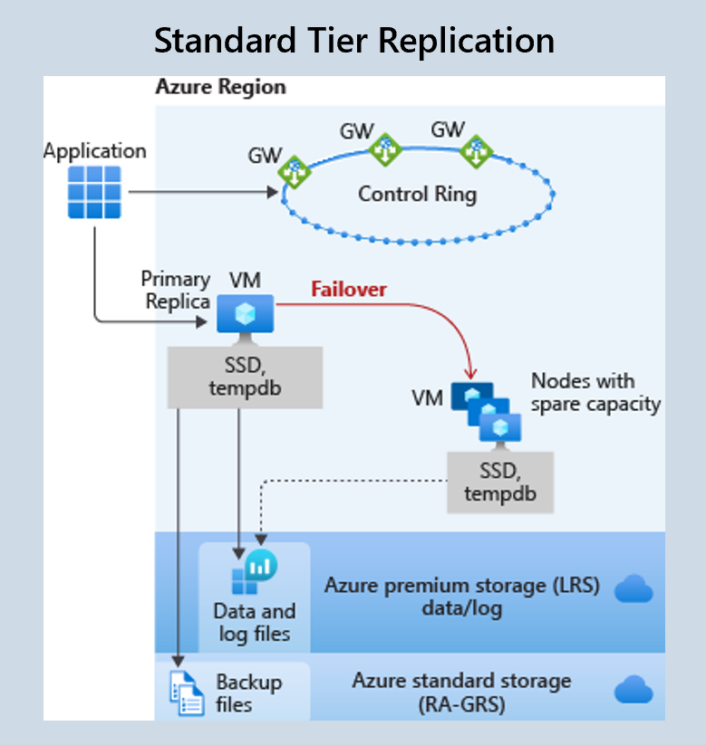
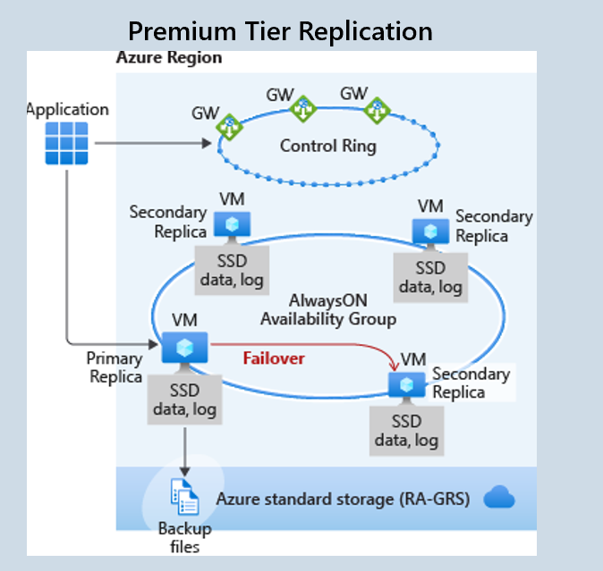
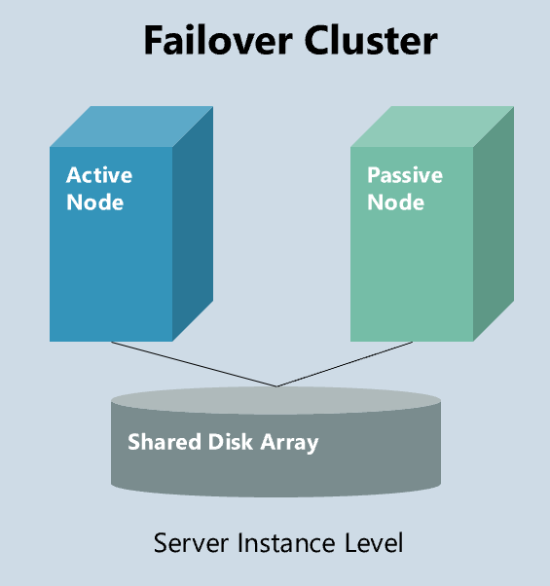
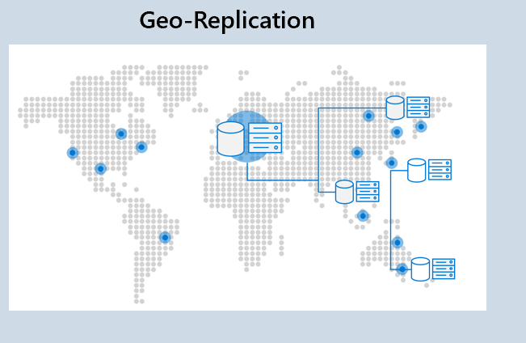
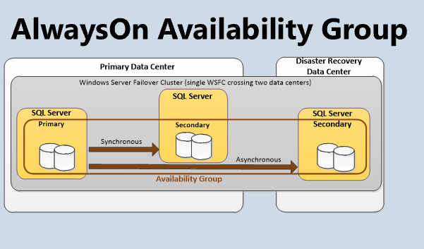
History of HA for Azure SQL
Transactional Replication
Snapshot Replication
Merge Replication
Accelerated Database Recovery
Always on Availability Groups
vCore model
Auto-failover groups
Zone Redundancy
Initial Release of Azure SQL Database
1989
SQL Server 1.0
1998
SQL Server 7.0
2005
SQL Server 2005
2016
SQL Server 2016
2014
2010
2018
1995
SQL Server 6.0
2000
SQL Server 2000
2012
SQL Server 2012
2019
SQL Server 2019
New Service Tiers
Geo-replication
Local db and tlog backups
Failover Cluster
Log Shipping
Database Mirroring
Fast Recovery
Enhanced Always on Availability Groups
Notes:
2010
First version of Azure SQL publicly released
Used our own internal “replica system” but ensured that we always kept three replicas available. We also automated processes like backups and kept multiple copies.
2014
All of Azure SQL was rearchitected and improved to be more efficient
Run on the same engine as on prem SQL Server, fully utilize all the HA greatness developed there
Presented to customers in the form of DTU service tiers.
Standard tier
Designed to meet the needs of most workloads.
Availability model is based on a separation of compute and storage.
Remote storage is Azure premium page blob storage which is replicated locally three times within the same region. This redundancy guarentees that data will be preserved even if sql server process crashes
Remote backups stored in globally redundant Azure storage. These backups are synchronously copied 3 times in primary region and then copied as well asynchronously to a secondary region.
Compute is operated by Azure Service Fabric that initializes the sql server process, controls health of node, and performs failover to another node of spare capacity if necessary. Data in azure blob storage is not affected by these moves and simple attach to newly initiated sql server process. Today always use accelerated database recovery for failover in order for this recovery to be as fast as possible.
Similar architecture to failover cluster introduced in 1998 but storage is not a single point of failure due to redundancy and resiliency provided automatically by Azure Storage
Premium tier
Designed for mission critical applications that require high IO performance, high transaction rate and guarantees of minimal performance impact to workload during maintenance activities.
Integrates compute resources and storage which is locally attached SSD on a single node.
HA is achieved with AlwaysOn replication similar to what we see in AlwaysOn availability groups by synchronously replicating this compute and storage to 4 node cluster.
Primary which accepts read-write workloads constantly pushes changes to 3 secondary's and guarantees quorum before committing each transaction.
This guarantees that if primary crashes for any reason that there is always a fully synchronized node readily available to failover to.
Backups are stored in same way as standard tier in globally redundant Azure storage
An extra benefit is that read only queries can be redirected to one of the secondary replicas using a feature called read scale out at no additional cost.
Geo-replication
Asynchronous replication of the full database including replicas to another Azure region
Allows for quick disaster recovery of individual databases in case of a regional disaster or large scale outage
Up to 4 readable secondaries
With this azure sql has a business continuity solution at a global scale that is simple for customers to use
2018
Introduce vcore model you see today
Allows you to independently choose compute and storage resources for database.
General Purpose has same availability architecture as standard
Business critical has same availability architecture as Premium
Auto-failover group
Manage geo-replication of a group of databases on a server to another region
Simplifies deployment and management of geo-replicated databases at scale
Based on distributed failover groups of SQL server introduced in sql server 2016
Zone redundant configuration for premium
Use availibity zones
What I view as the future of HA

Slide 12

AVAILABILITY ZONES
because the world is wack
Notes:
Photo source: https://www.freepik.com/premium-photo/vintage-nature-background-landscape-mountain_1327900.htm

Slide 13
What is an Availability Zone?
Availability Zones is a high availability offering that protects applications against datacenter level failures.
Region
Minimum of three physically separated locations
Three Availability Zones to support quorum-based workloads like SQL, Service Fabric, Cassandra, MongoDB.
Independent power, cooling, network
A facility level failure or single fiber path failure will affect only one zone.
Azure management services replicated across zones
Azure management services are redundant, so a single zone failure will not affect other zones. Azure maintenance orchestrated zone by zone.
Notes:
I will start this definition at an even higher level by first defining a region. An Azure region is a set of datacenters deployed within a latency-defined perimeter and connected through a dedicated regional low-latency network.
Availability Zones are unique and physically separate physical locations within an Azure region. To ensure resiliency, there's a minimum of three separate zones in all AZ enabled regions.
Each zone is made up of one or more datacenters equipped with independent power, cooling, and networking.
Zone-redundant configurations are when the Azure platform automatically replicates your service across Availability Zones to protect from single-points-of-failure since one zone failing will not impact the availability of another zone. Azure SQL Database currently offers a zone redundant configuration for the Business Critical and Premium service tiers, lets dive into what this looks like

Slide 14
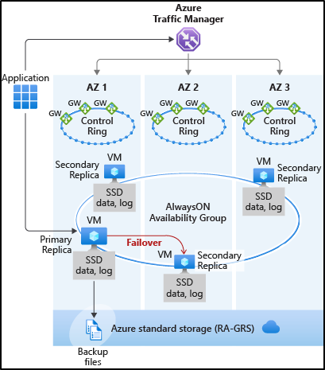
Zone redundant configuration
Business Critical/Premium tiers
4 replicas are automatically created in 3 different zones
Synchronous replication
Free
Notes:
Previous slide showed Premium/BC architecture – 4 synchronous replicas
With the introduction of Azure Availability Zones, SQL Database can place different replicas to different availability zones in the same region making your database resilient to a much larger set of failures, including catastrophic datacenter outages, without any changes to the application.
Uses synchronous replication still maintaining the near instantaneous failover and near zero data loss.
All additional resiliency at no extra costery

Slide 15
Demo:
Enabling zone redundant configuration
Portal
CLI
PowerShell
ARM
Notes:
Very easy to enable for any Premium/BC database using Gen5 hardware
Stress in the demo how it is free by pointing out that pricing doesn’t change in the pricing pane
Free, easy to configure, uses synchronous makes database resilient to large set of failures including datacenter outages. With this feature enabled, even a meteor can crash and destroy an entire datacenter and your database will still be up and running in a different Availability Zone within the same region (too bad the dinosaurs didn't have a zone redundant configuration).

Slide 16
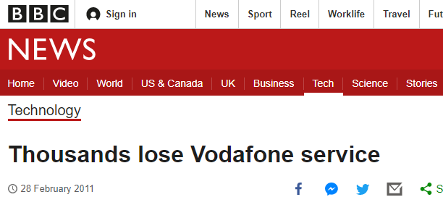


Real World Example
“several hundred thousand customers lost voice, text, internet access”
Reference: https://www.bbc.com/news/technology-12595681
Notes:
While meteor crashing into an entire datacenter seems like a dramatic case, there are actual many modern real world examples where a zone redundant configuration would save the day.
In 2011 Vodafone had a major downtime issue causing several hundred thousand customers to lose voice, text, and internet access causing news to spread. What caused this outage?
Thieves broke into one of the exchange centers and stole a bunch of computer equipment and network hardware.
Just to explain the context of this picture this cartoon fox called Swiper is from a major children’s cartoon in the US who is known for stealing or “swiping” things. It’s best to keep Swiper away from datacenters, but even if he were to break in the zone redundant configuration would still save the day and have databases still be up and running in a different AZ in the same region.
News source:
https://www.bbc.com/news/technology-12595681
Picture sources:
https://www.web24.com.au/library/getting-started-servers-everything-need-know
https://digitalstrips.com/

Slide 17
SLAs
service tier | Single zone SLA | Multiple zones SLA
Premium, Business critical | 99.99% | 99.995%
Max downtime:
52.56 min/year
Max downtime:
26.28 min/year
SLA for Azure SQL Database
Notes:
Fun examples aside what value does this zone redundancy actually bring in terms of availability for databases?
To understand the value let’s look at our SLA for uptime which is the most important metric for availability. Azure SQL Database offers a baseline 99.99% availability SLA across all of its service tiers, and provides a higher 99.995% SLA for the business critical and premium databases with zone redundancy enabled. By integrating with Azure availability zones, we leverage the additional fault tolerance and isolation that AZs provide, which in turn allows us to offer a higher availability guarantee using the compute and storage redundancy across AZs and the same self-healing operations.
If you remember from earlier this 99.995% SLA offers a 50% reduction of downtime as the baseline 99.99%. In the time frame of a year for the 99.99% SLA that exists for non zone redundant databases the downtime should not exceed 52.56 minutes per year. Zone redundancy increases availability to 99.995%, which means a maximum downtime of only 26.28 minutes per year.

Slide 18
Regions that support Availability Zones
UK South
Central US
North Europe (preview)
West Europe
West US 2 (preview)
East US
France Central
East US 2
Japan East
Southeast Asia
Australia East
For up to date information about the regions that support zone redundant databases, see Services support by region.
Notes:
This map shows all the regions where the zone redundant configuration is currently available for Azure SQL Premium and Business Critical databases and elastic pools. This slide provides a link to the public Azure documentation that keeps track of the most up to date information on the regions where different Azure services support Availability Zones as this AZ greatness is added to more and more regions.

Slide 19
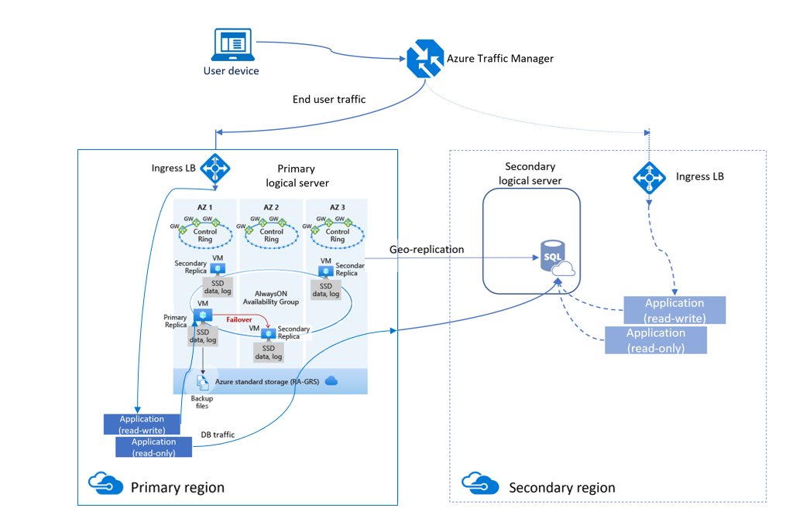
Zone Redundancy and Geo-replication
Zone redundancy should be enabled for all production databases
Geo-replication should be enabled for more critical databases
Tier 1 apps should use a combination of Zone Redundancy and Geo-replication
Notes:
After talking about how great zone redundancy is and also discussing Geo replication this leads to the common question of what to use when?
It is advised that customers use the zone redundant configuration for all production databases. This synchronous replication is the only way to be protected against zonal outages. Since this comes at no extra cost to the customer for Premium and Business Critical databases and provides additional availability there is no reason for these customers to not enable zone redundancy for these databases.
For GeoDR it is advised that customer use GeoDR for more critical dbs where it is necessary to avoid regional failure. This asynchronous replication allows for disaster recovery protection. While this costs more this is the only way to be protected against major disasters across an entire region.
It is advised that customers use both ZR and GeoDR for tier 1 apps as shown in this diagram. This combination allows the high availability with quick failover from zone redundancy while also guaranteeing that there is no data loss in a zonal or regional failure. Work together to make an unstoppable database.

Slide 20

Summary
Thanks for visiting!
Notes:
Photo source: http://vintagetravelpostcards.blogspot.com/2012/05/florida-beaches.html

Slide 21



What we learned today
HA has significantly matured over the last 30 years
Azure SQL offers built-in industry leading HA
Availability zones are the future of High Availability
HA is crucial
Notes:
HA is crucial – The world isn’t perfect and neither are any hardware or software. Ready embrace this facts by using systems that minimize the effects of a single failing component with as little downtime as possible.
Matured – HA has improved so much from 1989 where the closest thing to HA was infrequent backups taken on the same server. Now have sync and async replication options with several replias, automated failoves, virtualization of connections to replicas, groupings of databases into single units of failure , speedier recovery systems, and built in resiliency at a global scale in the cloud.
HA – built in maintenance and fault tolerance for all azure sql database giving a simple hands off experience. 99.99% uptime SLA across tiers and 99.995% when utilizing zone redundant configuration for BC/Premium
Availability zones future of HA – Synchronous replication guaranteeing no lag in committed transactions to secondaries so there is always another replica readily available to failover to with no data loss within the same region even when a full data center goes down

Slide 22
Resources
CLI commands to enable zone redundancy:
–zone-redundant {false, true}
New database
az sql db create
az sql elastic-pool create
Existing database
az sql db update
az sql elastic-pool update
PowerShell commands to enable zone redundancy:
-ZoneRedundant
New database
New-AzSqlDatabase
New-AzSqlElasticPool
Existing database
Set-AzSqlDatabase
Set-AzSqlElasticPool
Documentation:
High-availability and Azure SQL Database
Regions that support Availability Zones in Azure
Regions and Availability Zones in Azure
SLA for Azure SQL Database
Geo-replication
Automated backups
Long term retention
Auto-failover groups
Transactional replication
Snapshot replication
Merge replication
Failover cluster
Database mirroring
AlwaysOn Availability Group
Log Shipping
Notes:
Resources of concepts described today as well as info on how to configure ZR for CLI and powershell

Slide 23
Thank You
Notes:
Thank you:
Ben and everyone who put together the new stars of data conference for providing this great learning opportunity for me
Bob Ward – patiently taking the time to walk through history of HA for Azure SQL with me
Anna Hoffman – amazing and inspiring mentor
Roommates for always supporting me allowing me to use the living room for this presentation
Questions?

Slide 24
Appendix

Slide 25

Geo Replication
HA concepts
History of HA through SWL Server
Azure SQL High Availability
Zone Redundancy
Summary

Slide 26
History of HA for SQL Server
Transactional Replication
Snapshot Replication
Merge Replication
Enhanced Always on Availability Groups
Always on Availability Groups
1989
SQL Server 1.0
1998
SQL Server 7.0
2005
SQL Server 2005
2016
SQL Server 2016
1996
SQL Server 6.0
2000
SQL Server 2000
2012
SQL Server 2012
2019
SQL Server 2019
No Replication
Failover Cluster
Database Mirroring
Fast Recovery
Domain Independent Always on Availability Groups

Slide 27
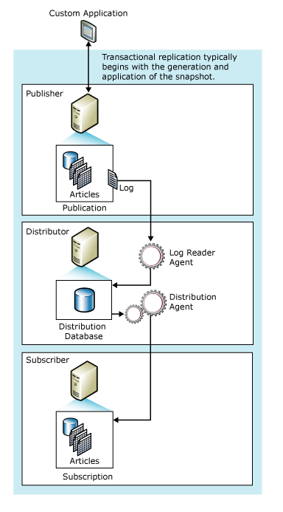
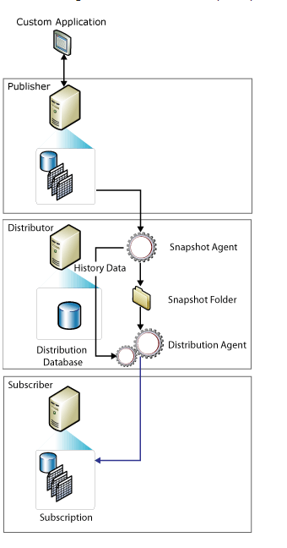
Transactional Replication
Snapshot Replication

Slide 28
Failover Cluster
Active Node
Passive Node
Shared Disk Array
Server Instance Level

Slide 29
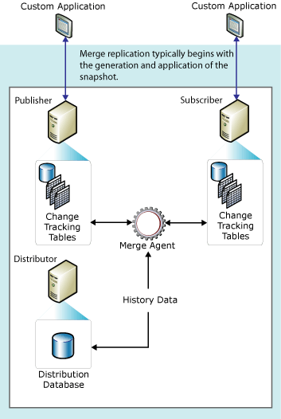
Merge Replication

Slide 30
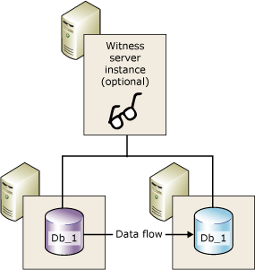
Database Mirroring
Fast Recovery
Analysis
Redo
Database Available
Undo

Slide 31
AlwaysOn Availability Group

Slide 32
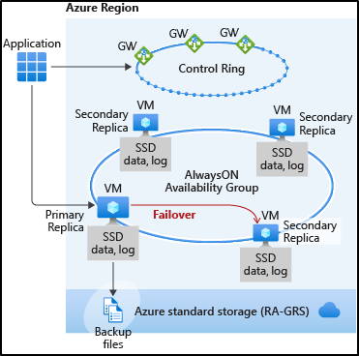
Premium Tier Replication

Slide 33
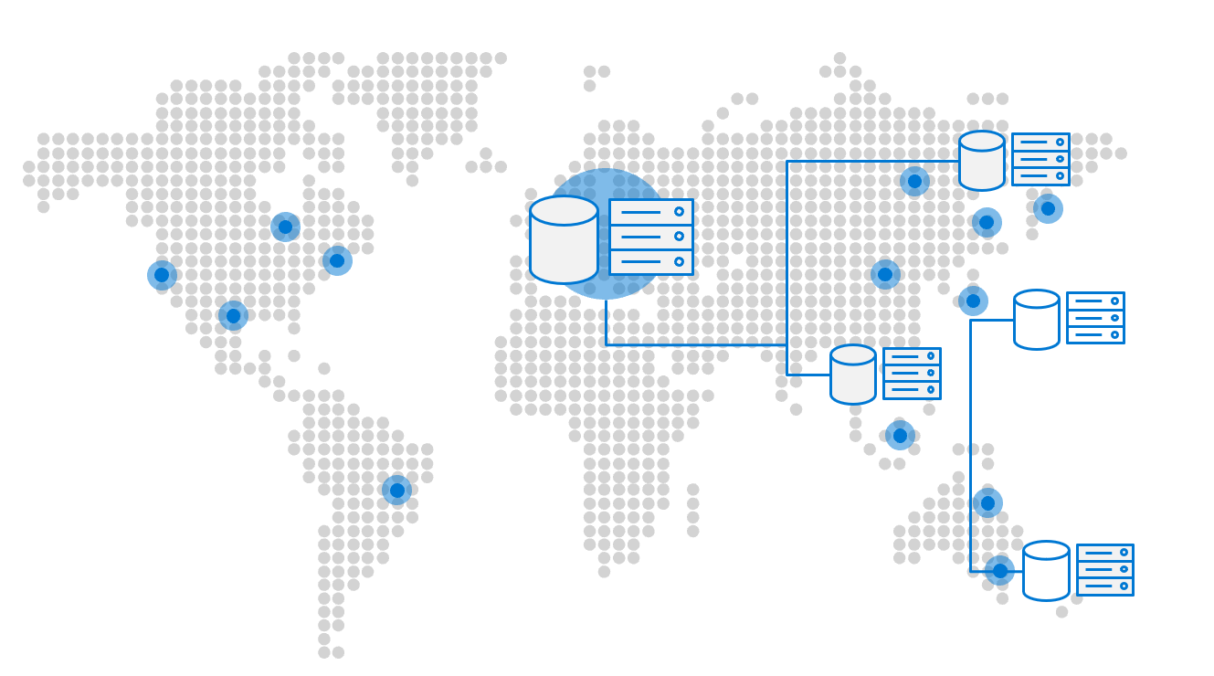
Geo-Replication

Slide 34
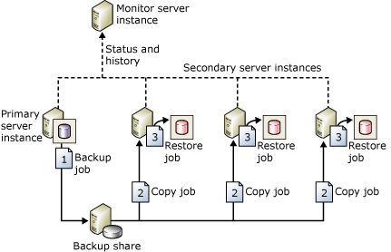
Log Shipping

Slide 35
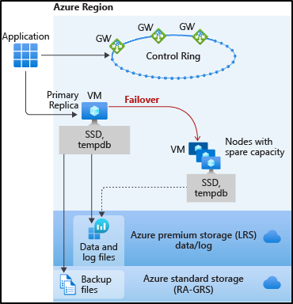
Standard Tier Replication

Slide 36
Geo Replication
Mission-critical business continuity on your terms, via programmatic APIs
Service levels | All
Readable secondaries | Up to 4
Regions available | Any Azure region
Replication | Automatic, asynchronous
Manageability tools | REST API, PowerShell, or Azure Portal
Recovery time objective (RTO) | <30 sec
Recovery point objective | <5sec
Failover | On demand
Up to 4 secondaries

Slide 37
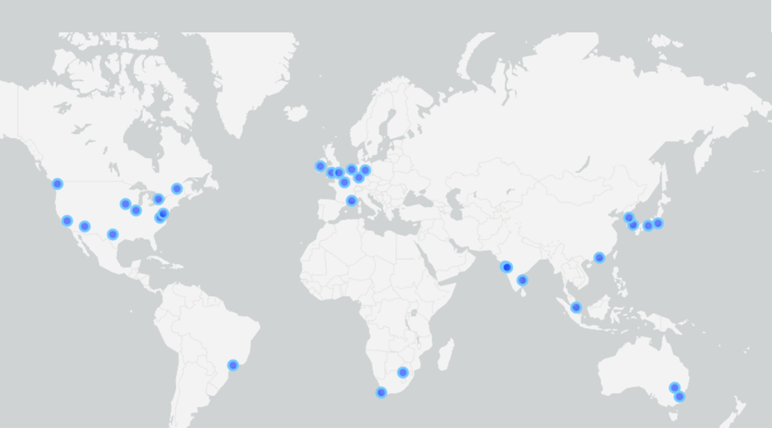
Brief Overview of DR
Point-in-Time Restore
Long-term Retention
Geo-Replication
Auto-failover groups
Notes:
backups enable database restore to a point in time within the configured retention period. A a self-service disaster recovery capability that we offer which automatically creates full backups, differential backups, and transaction log backups. Full database backups are created weekly, and differential database backups are generally created every 12 hours. Transaction log backups are generally created every 5 to 10 minutes.
In the case where you need database backups beyond the 7-35 day provided by these automated backups you can configure long-term retention (LTR) of full backups for up to 10 years in Azure Blob storage. With LTR policy, the weekly full backups are automatically copied to a different read access geo-redundant storage container.
Another DR capability in Azure SQL is geo-replication. It allows you to create readable secondary databases in the same or different region. It is designed as a business continuity solution that allows the application to perform quick disaster recovery of individual databases in case of a regional disaster or large scale outage. With geo-replication enabled the application can initiate failover to a secondary database in a different Azure region however this failover must be initiated manually by the application or the user. After failover, the new primary has a different connection end point.
Auto-failover groups is a declarative abstraction on top of the existing active geo-replication feature, designed to simplify deployment and management of geo-replicated databases at scale. It essentially allows you to manage replication and failover of a group of databases on a SQL Database server or all databases in a managed instance to another region.

